Slide 1
Road Safety Week 2020
Primary 4 -7

Slide 2
‘Safe Travel to School’
The theme for Road Safety week at TMPS this year is ‘Safe travel to school’. Please use some of the suggested activities and links below to plan a few activities for your class to support their understanding of what safe travel looks like. On Friday 20th November 2020, we will host a whole school assembly to share all of the learning that has been taking place throughout the week and to reiterate the key messages to all of our pupils.

Slide 3
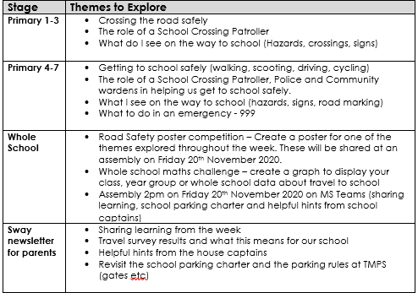
Overview of the themes/ tasks for
Road
Safety week

Slide 4
Whole School Maths Challenge
(Maths Task)

Slide 5
Whole School Maths Challenge
You are going to use your information handing skills to create a graph that will display how your class, stage or our school travel to school.
Remember to include:
Labelled axis
A suitable scale
A title for your graph
Notes:
Using the data for your class, year group or the whole school, create a graph to display how pupils at TMPS travel to school.
The data information is on the following slides. Delete the data the you do not need when using this with your class.
Use this data to prompt discussion about the most and least common modes of transport used and to lead into discussion about the different hazards each method of transport poses.

Slide 6
P4a
Walk | 10
Cycle | 0
Scoot | 0
Bus | 10
Car | 10
Other | 0

Slide 7
P4b
Walk | 7
Cycle | 2
Scoot | 1
Bus | 6
Car | 12
Other | 0

Slide 8
P4c
Walk | 13
Cycle | 1
Scoot | 0
Bus | 7
Car | 9
Other | 0

Slide 9
P5a
Walk | 5
Cycle | 2
Scoot | 2
Bus | 9
Car | 9
Other | 0

Slide 10
P5b
Walk | 9
Cycle | 3
Scoot | 1
Bus | 4
Car | 13
Other | 0

Slide 11
P5c
Walk | 9
Cycle | 1
Scoot | 1
Bus | 2
Car | 17
Other | 0

Slide 12
P6a
Walk | 11
Cycle | 3
Scoot | 0
Bus | 5
Car | 11
Other | 0

Slide 13
P6b
Walk | 8
Cycle | 0
Scoot | 0
Bus | 11
Car | 8
Other | 0

Slide 14
P6c
Walk | 12
Cycle | 3
Scoot | 3
Bus | 5
Car | 4
Other | 0

Slide 15
P6 stage
Walk | 31
Cycle | 6
Scoot | 3
Bus | 21
Car | 33
Other | 0

Slide 16
P7a
Walk | 15
Cycle | 4
Scoot | 0
Bus | 7
Car | 6
Other | 0

Slide 17
P7b
Walk | 4
Cycle | 1
Scoot | 0
Bus | 3
Car | 9
Other | 0

Slide 18
P7c
Walk | 13
Cycle | 3
Scoot | 1
Bus | 4
Car | 4
Other | 0

Slide 19
Whole School (at the time of totalling)
Walk | 181
Cycle | 24
Scoot | 23
Bus | 104
Car | 184
Other

Slide 20
Whole School Poster Challenge
(Art Task)

Slide 21
Safe Travel to School Poster Challenge
Create an eye-catching poster to remind pupils/parents/carers to travel safely to school.
You can choose any of the focus themes from this week including:
the importance of being seen when it is dark
safe cycling
avoiding hazards
what to do in an emergency
Notes:
All pupils should create a poster for the TMPS Road Safety competition by Thursday 19th November (Megan will collect these after school on Thursday and will photograph some for the assembly on Friday 20th).

Slide 22
Safe Travel to School Poster Challenge
All posters should be submitted by Thursday 19th November and some will be selected to be shared at the whole school assembly on Friday 20th November.
Notes:
Please ensure pupil names and class details are on the back of each poster.

Slide 23
Road Safety Discussion
(Discussion Task)

Slide 24
Road Safety Discussion
To start of Road Safety Week, we are going to discuss some statements to get an understanding of the thoughts and opinions of our class.
Discuss the statements on the next slide in your groups/pairs and sort them into 3 categories: ‘Fair’, ‘Unfair’ or ‘Undecided’.
Notes:
Use the statements on the next slide to discuss road safety with your class. You can either discuss and sort them altogether or ask pupils to work with their shoulder partner to sort them. Once they have done this, ask for feedback and address the facts they have found unfair or are undecided about.
In the shared area, there is a sheet saved with the statements typed on to it. You can use this to distribute if you would rather the pupils physically sorted these at their tables.

Slide 25
Children should not cross the road by themselves
Children should walk to school with an adult
Cars should not drive faster than 20mph in areas where people live
Children should cross a road only where there is a pedestrian crossing
Children should not have a mobile phone in their hands when walking to school
Walking and cycling should be made easier and safer in communities
If more people walked and cycled instead of driving, it would reduce road casualties and pollution
Parents should not drop their children off outside school
Parents should not be allowed to use their cars for taking children to school
Drivers should not use a hands-free phone when driving

Slide 26
Discussion
What statements did the class agree on?
What statements did the class disagree on?
Look at any statements that you sorted into the undecided column? Why could you not make a decision for these ones? What was the overall consensus from the class for these statements?
Why do you think some people in the class had different opinions?

Slide 27
Safe Travel to School
(Discussion/Writing Task)

Slide 28
Walking
Where there is a pavement or footway, use it. Take care when crossing cycle lanes on the road. Cyclists may be travelling quietly but can be faster than other traffic.
If you are looking after someone younger than you, always hold their hand when on the road.

Slide 29
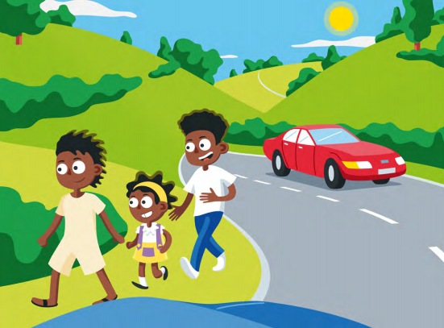
Walking
When there is no pavement, walk on the right hand side of the road to face the traffic coming towards you.
Walk one behind the other at bends in the road or at night, or if there is a lot of traffic. Take special care if you cannot see the road very far ahead.

Slide 30
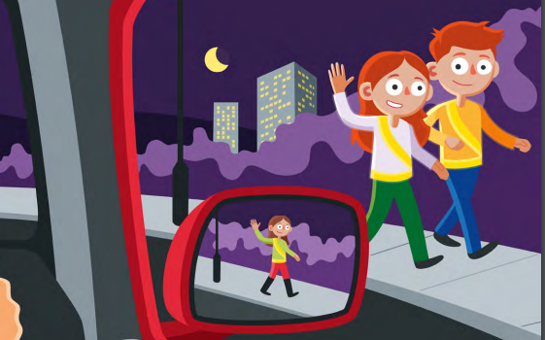
Walking at Night
Help other road users to see you. Wear or carry something light coloured, bright or fluorescent.
Fluorescent materials are good. They show up in daylight and at dusk. Reflective materials are good at night.
At night a driver can usually see you from about 30 metres away. If you wear high-vis gear they can see you from 160 metres away (more than five times further!)
Notes:
Stay Bright Road Safety Advert
https://www.youtube.com/watch?v=IemaPHDPQ54

Slide 31
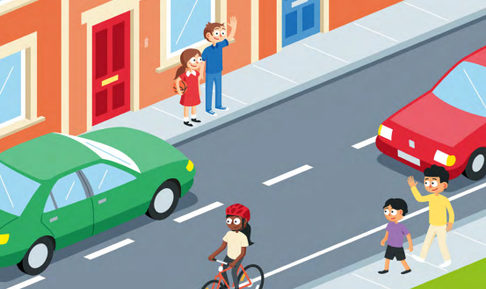
Walking - Crossing the Road
1. First find a safe place to cross and where there is space to reach the pavement on the other side. Where there is a crossing nearby, use it. Otherwise choose a place where you can see clearly in all directions.
Try to avoid crossing between parked cars, on a blind bend or close to the brow of a hill. Move to a space where drivers and riders can see you clearly. Do not cross the road diagonally.

Slide 32
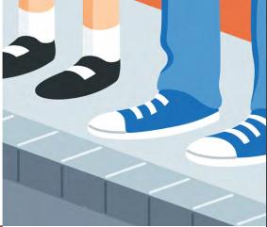
Walking - Crossing the Road
2. Stop just before you get to the kerb …where you can see if anything is coming. Do not get too close to the traffic. If there is no pavement, keep back from the edge of the road but make sure you can still see approaching traffic

Slide 33
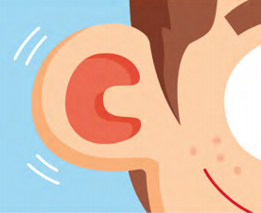
Walking - Crossing the Road
3. Look all around for traffic and listen Traffic could come from any direction. Listen as well because you can sometimes hear traffic before you see it.

Slide 34
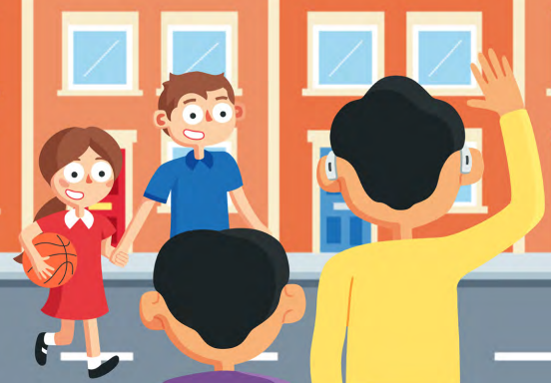
Walking - Crossing the Road
4. If traffic is coming, let it pass Look all around again and keep listening. Do not cross until there is a safe gap in the traffic and you are certain there is plenty of time. Remember, even if traffic is a long way off, it may be approaching very quickly.
5. When it is safe, go straight across the road – do not run Keep looking and listening for traffic while you cross, in case there is any traffic you did not see, or in case other traffic appears suddenly. Look out for cyclists and motorcyclists travelling between lanes of traffic. Do not walk diagonally across the road.

Slide 35
Walking
Watch the video below to learn about sensible decisions you can make when travelling to school.
https://www.think.gov.uk/resource/expect-the-unexpected/
Once you have watched the video, take part in the quiz. Can you remember all of the safety information that you were told about in the video?
Notes:
Quiz link –
https://create.kahoot.it/share/e297ae0a-44ef-434d-9d65-178f274fe27f
Game for the iPads -
https://www.think.gov.uk/games/take_the_lead/take_the_lead.html

Slide 36
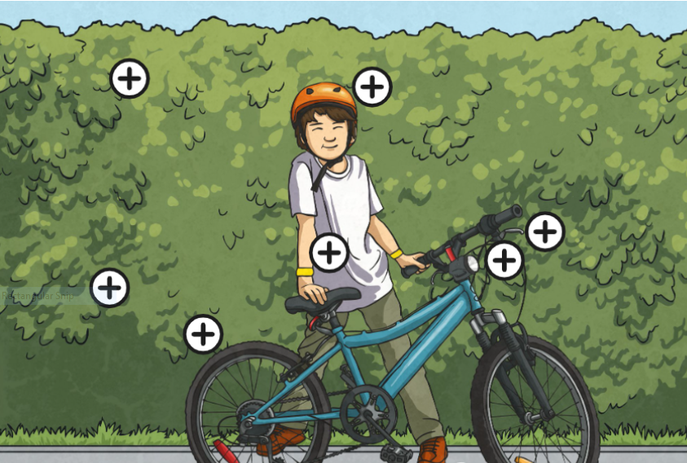
Cycling
Check your front and rear breaks are in order before you set off on a ride.
Always wear an approved fitted helmet when riding your bike.
Be aware! Don’t wear headphones or use your mobile phone when riding a bike!
Use the correct signals before your turn.
If you are riding at night/when it is dark, you should have a white light at the front and a red light at the rear of your bike that you switch on.
Check the pressure of your tyres before you set off on a ride. Check for punctures.
Be seen! Wear light coloured or fluorescent clothing. At night, wear a reflective band or jacket.

Slide 37
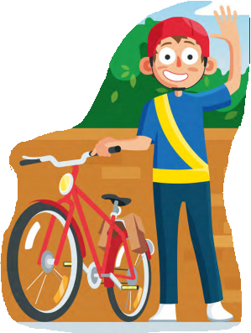
Parking your Bike
Remember to dismount from your bike before entering the playground.
Always park your cycle thoughtfully so that it is not in the way of other people.
Lock it to prevent it being moved from where you have left it.

Slide 38
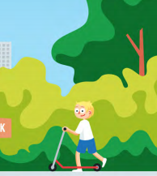
Scooting
When rollerblading, scooting or skating… Make sure you do so safely and without causing a nuisance to others.
Use the pavements, and take care near other pedestrians, particularly young children and the elderly.
Do not rollerblade, scoot or skate across the road. If you need to cross the road hold onto your scooter or skateboard and walk across the road. Always use the Green Cross Code when crossing.

Slide 39
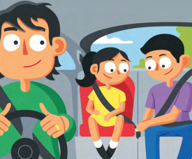
Car
Seatbelts MUST be worn at all times.
REMEMBER:
Do not block the driver’s view in the mirror.
Never lean or wave out of the window or throw or hang anything out.
Only open doors or windows if it is safe.
Keep your hands away from door handles while the car is moving.

Slide 40
Bus
Seatbelts MUST be worn at all times.
When you wait for a bus, stand on the pavement, well back from the traffic. It is dangerous to play around at bus or tram stops.
Always do what the driver tells you and do not distract them.
If you do need to cross the road after getting off the bus, wait for it to move away first so that the driver can see you, and you can see approaching traffic.

Slide 41
Safe Travel Leaflet
As part of road safety week, think about some helpful hints you could give our pupils to keep them safe on their journey to and from school.
Create a leaflet to display some of the helpful hints for each method of getting to and from school.
Remember to include the key points for each travel method.

Slide 42
People who help us travel to school safely
(Discussion Task)

Slide 43
Who helps us get to school safely?
Think about the people who help us get to and from school safely (lollipop patroller, police, community wardens, parents/carers), bus drivers).
What are their roles and responsibilities?
What do you do if they are not there to help you?
Notes:
For this task, you can either discuss the roles as a class or there is opportunity for the pupils to work with shoulder partners to create mind maps for each and then share these with the class.
Although community wardens and police are not always present when the children are going to school, they will at times be present, so try to get the pupils to think about what role they would be taking on in these circumstances. They are also likely to meet them when moving around within the community so what are there roles in terms of safe travel within the community?

Slide 44
What I See on My Journey to School
(Quiz)

Slide 45
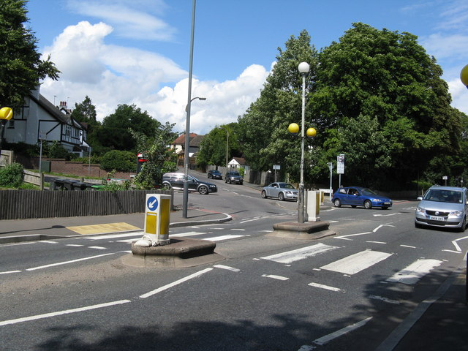

On your way to school you will see…
What do you see on your way to and from school?

Slide 46
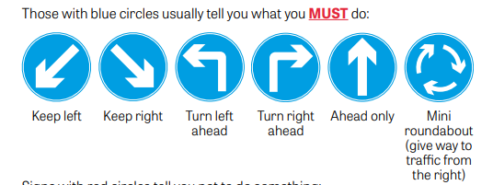
Road Signs

Slide 47
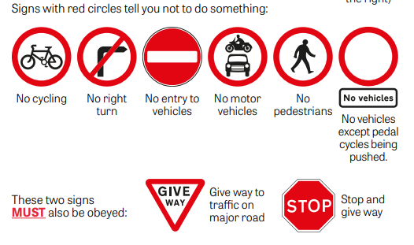
Road Signs

Slide 48
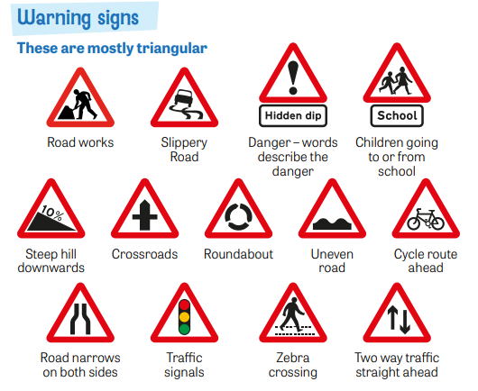
Warning Signs

Slide 49
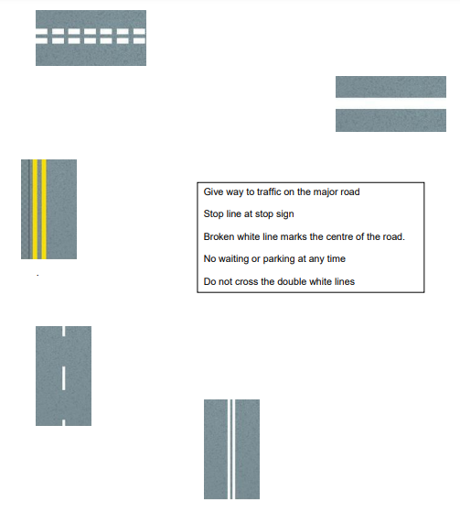
Road Markings

Slide 50
Safe Crossing places
Traffic Lights on Woodhill Road
Traffic Lights on Angus Avenue
School Crossing Patroller on Angus Avenue

Slide 51
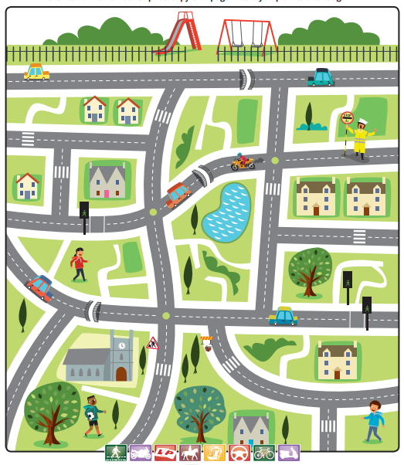
Hazards
Can you spot the hazards in the image?

Slide 52
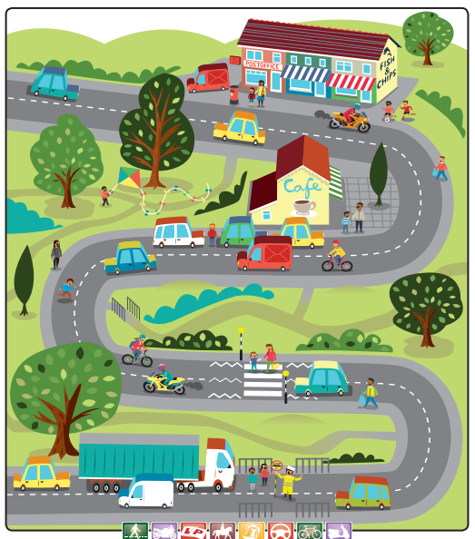
Hazards
Can you spot the hazards in the image?

Slide 53
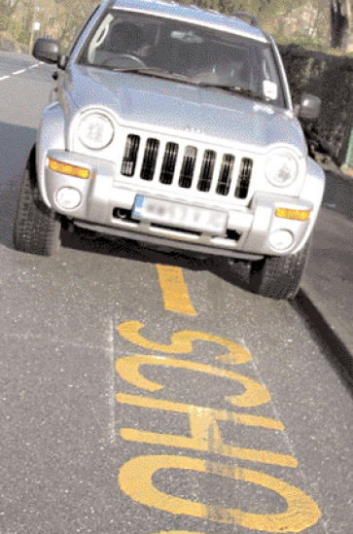
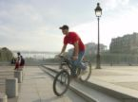
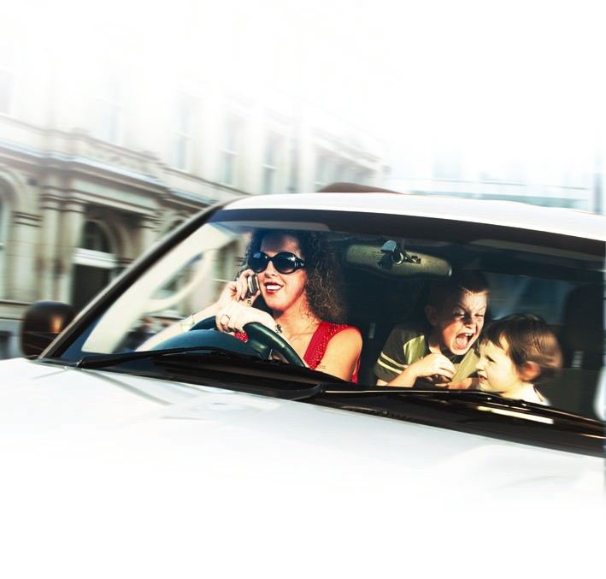
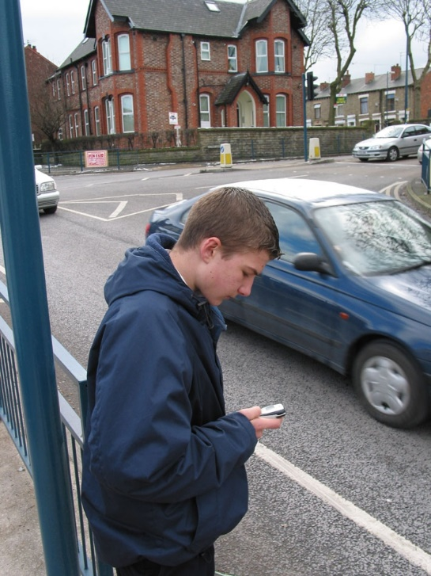
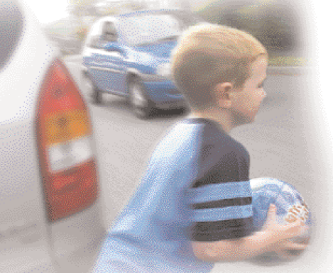
Danger zone
Can you spot the hazards in the images?
Notes:
Ask the class to spot what behaviour in the pictures is dangerous and what is safe.
Use a red pen to circle and put a line through the dangerous behaviour and use a green pen to tick the safe behaviour. (NB: there may be more than one possible tick or cross per picture.)
Dangerous behaviour:
Cycling without a helmet
Crossing the road while texting
Talking on a mobile while driving
Not belting up in the car
Crossing next to a parked car
Playing a ball game in the road
Parking on yellow lines outside a school
Safe behaviour:
Wearing bright, reflective material at night
Wearing a cycle helmet
Holding hands
Crossing at a pelican crossing
Using a booster seat and belting up

Slide 54
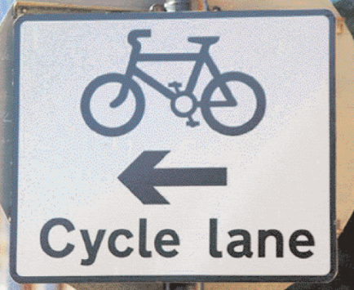
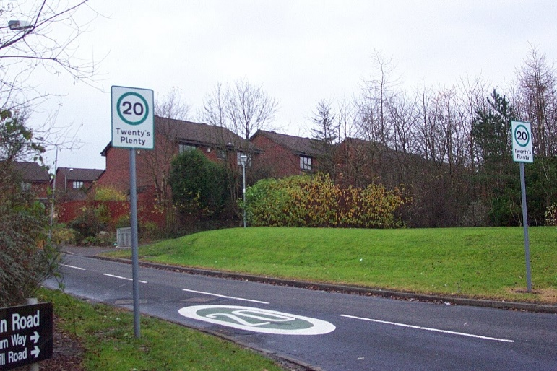
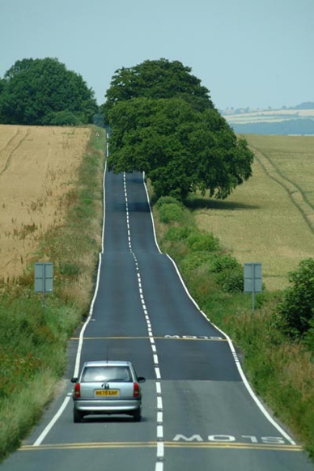
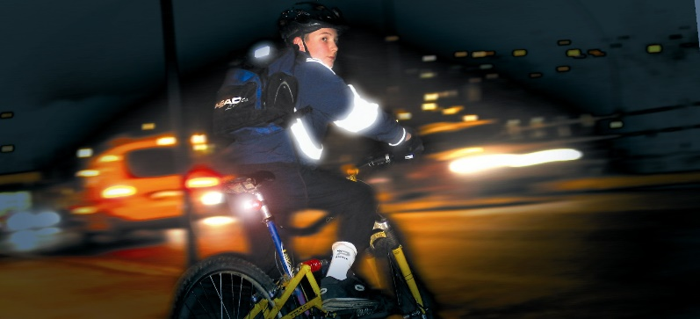
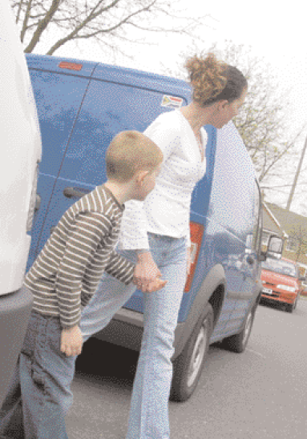
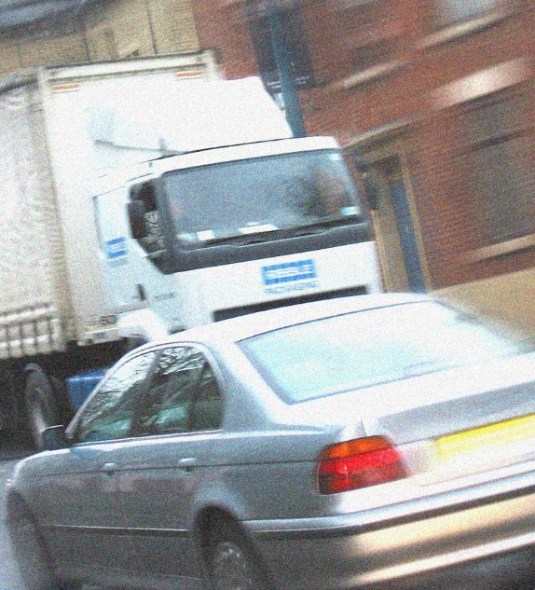
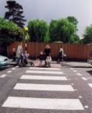
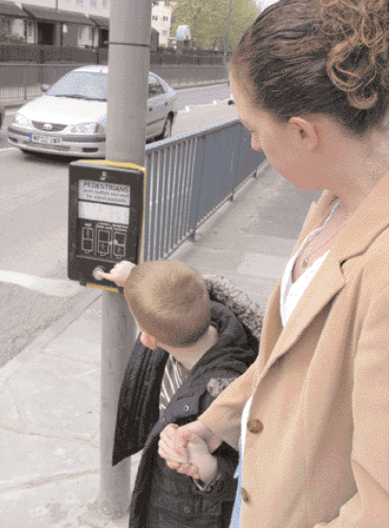
Hazard spot
Can you spot what’s a hazard
and what’s there to keep you safe?
Notes:
Sometimes people put themselves in danger by the things they do.
But sometimes we’re put in danger by the things around us.
Explain the meaning of a ‘hazard’ – i.e. something in your surroundings that could put you in danger.
Ask the class to spot what on these roads is a ‘hazard’ and what’s there to help them stay safe. Get them to use a red pen to circle and the hazards and use a green pen to tick the things that are there to help them stay safe.
Hazards:
Darkness – if you walk or cycle in the dark, or when it’s foggy or raining, it’s harder for drivers to spot you
Fast traffic – the faster vehicles go, the more dangerous for people on foot and bikes
Large vehicles like trucks and buses – these vehicles often do important jobs, like carrying food to shops or carrying people to work. But because the vehicles are big, the drivers have ‘blind spots’. This means sometimes they can’t see things near the vehicle – like kids standing behind them or right next to them. Keep well away from these vehicles, even if they’re not moving
Parked vehicles – it’s dangerous to cross between parked vehicles because it’s harder for drivers to spot you
Roads with no pavements – it’s dangerous to walk along roads like this, because there’s nothing to separate you from the traffic, and drivers might not expect there to be any pedestrians on the road
What’s there to help you stay safe:
Pelican crossings and zebra crossings – they’re there to help you get across the road safely, so always use them if you can
20mph zones – roads with slower speed limits are safer for people on foot and bicycles
Cycle lanes – help to keep traffic away from cyclists

Slide 55
Planning a safe journey to school
Think about the journey you make from home to school.
What hazards do you sometimes see?
How do you make sure you avoid those hazards?
What things are in place to keep you safe when you are travelling to school?
Notes:
At this point, you can ask the pupils to do this as a discussion task or a written task where they can plan a safe journey to school.
You can also use google maps here to show them where there are safe crossings near our school (e.g. the traffic light on Woodhill Road, the location of the lollipop patrollers etc)

Slide 56
999 What is your emergency?

Slide 57

Keep safe
Basic Rules:
If an accident happens, it is most important that before you do anything else you must ensure that it is safe to approach and offer help.
If anything happens to you then you will be unable to help anyone else. This could mean one casualty then becomes two.

Slide 58
Hazards
What is a hazard?
Put simply, a hazard is a source or a situation which has the potential to cause damage, injury or illness.
Hazards can have an impact on people, property, the environment or a combination of these.
Simply, a hazard is something that could cause harm.
Discussion time
Think of 3 things that could be a hazard in a road traffic accident.
Discuss your answers.
Notes:
Answers may include:
- An object falling from a height (shelves)
- Tripping on wires/chair legs
- Sharp corners of desks/tables
- Liquids being spilt
Stacked boxes
Electrical equipment not being cared for
Broken equipment/stationary
Shelving/bookcases/cabinets – things may fall if not used properly/cared for

Slide 59


Calling for help
If there is an emergency you can dial 999 or 112 to get the emergency services.
The call operator will ask, “Which service do you require?
Fire, Police or Ambulance?
You will need to tell them which
service you need.
It is really important that you give information to help them arrive at the correct location i.e. address/location.
Notes:
Emergency
Fire, Police or Ambulance
Reinforce that 999/112 is only to be used In a real emergency. False calls can divert help away from where it is really needed.

Slide 60
Watch this video
https://youtu.be/YOwYPhJfYx4

Slide 61



Remember LIONEL
Location. Tell them where the emergency is and where you want them to arrive.
Incident. Tell them what has happened.
Other services. Do you need more than one?
Number of people that are involved.
Extent of the injuries. What types of injuries do people have?
Location. Repeat again where they need to arrive.
Question:
What is the correct address for two or three places you often visit?

Slide 62
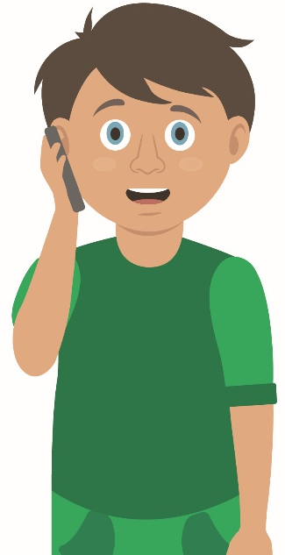

Your turn: Calling for help
1. Check for danger
Always make sure the area is safe
2. Call 999/112
If it is an emergency, call 999 or 112. Remember LIONEL to give them important details.
3. Reassure casualty
Keep casualty reassured
Stay with them until help arrives
  4. If you have been taught any first aid which may be useful, then use it.
Notes:
Scenario cards are available which the teacher can use to make the practical activity relevant in a certain context for students.

Slide 63
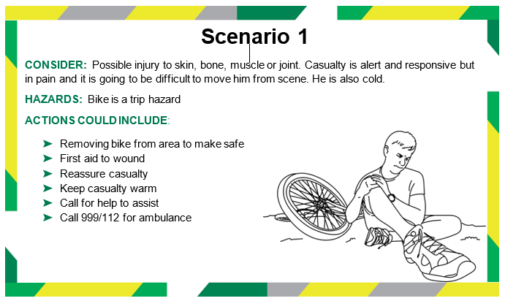

Slide 64
Tasks
Click the link below to access a short video and interactive activities based on an emergency road traffic situation.
https://roadsafety.scot/learning/first/streetsense2/breaking-news/

